Slide 1
Homework 3
Kun-Ta Chuang
Department of Computer Science and Information Engineering
National Cheng Kung University
Presenter: Chai-Shi Chang
Email: cschang@netdb.csie.ncku.edu.tw

Slide 2
Outline
Overview
Data
Input & Output Data
Workflow (作業流程)
Hand in Method
Schedule
Evaluation (評量方法)
Grade
Question
Paper Reference

Slide 3



Overview
You will act as a house owner in this HW3
Your house equipped with appliances and solar power plant
Your house is in a community microgrid with a total 40 households
You can decide to buy or sell the power from the microgrid through a local power trading platform
You can still consume the power from the main grid by a fixed price
Goal: Design an agent for bidding power to minimize your electricity bill
Solar Power Plant
Appliances
Notes:
Community microgrids (focus of this article) – are microgrids designed to service a designated community. They may or may not have a connection to the main grid. The focus of this type of microgrid is to pool local resources (mainly small-scale renewables) to maximise energy self-reliance. They may also be built or joined for financial reasons – such as high electricity prices on the main grid.

Slide 4

Overview

Slide 5




交易流程
1. Agent掛單，平台收集投標策略
* 數據為示意所用，結果以作業平台為準則
投標策略
1. 買10度5元
2. 賣12度4元
3. 賣5度7元
投標策略
1. 賣10度5元
2. 12度4元
3. 賣5度7元
投標策略
1. 買11度5元
2. 買8度4元
3. 買5度7元
2. 平台媒合，公佈得標結果
媒合邏輯
投標結果
4. 電費結算
Unit A
Agent 1
3. 交易流程
Unit B
Agent 2
Unit C
Agent 3
得標：買5度4元
得標：賣5度4元
未得標
1.Agent掛單
2.媒合與結果
3.交易(示意)
4.電費結算

Slide 6
Data
50 households synthetic data
Hourly Power consumption (kWh)
Hourly Solar Power generation (kWh)
Hourly Bidding records
12 months of data
8 months for training
1 months for validation
3 months for testing

Slide 7
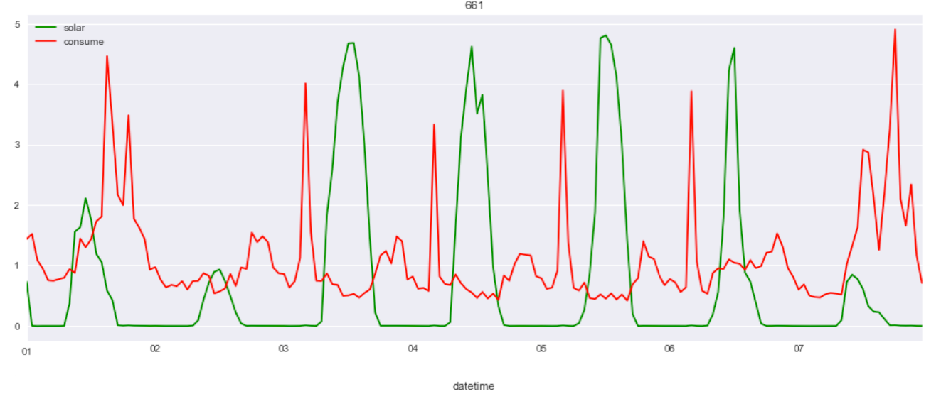
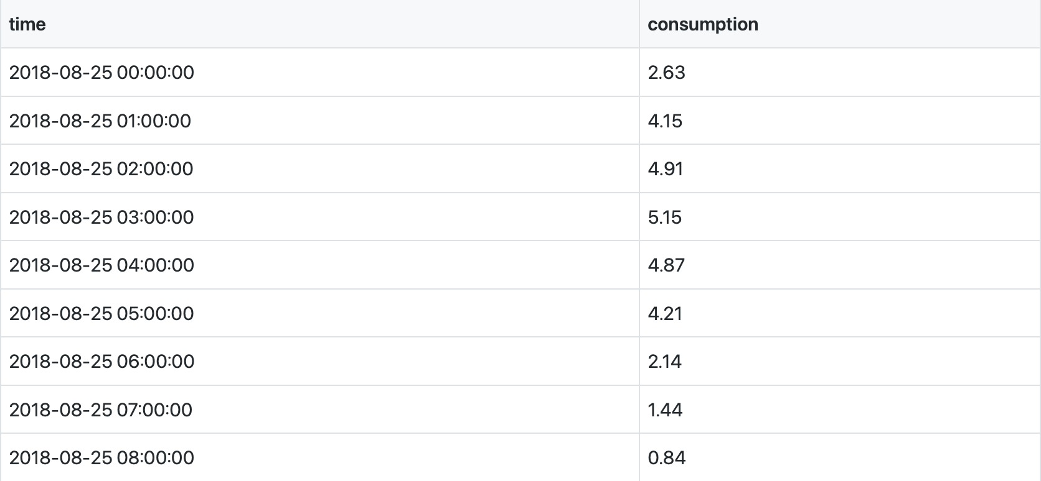
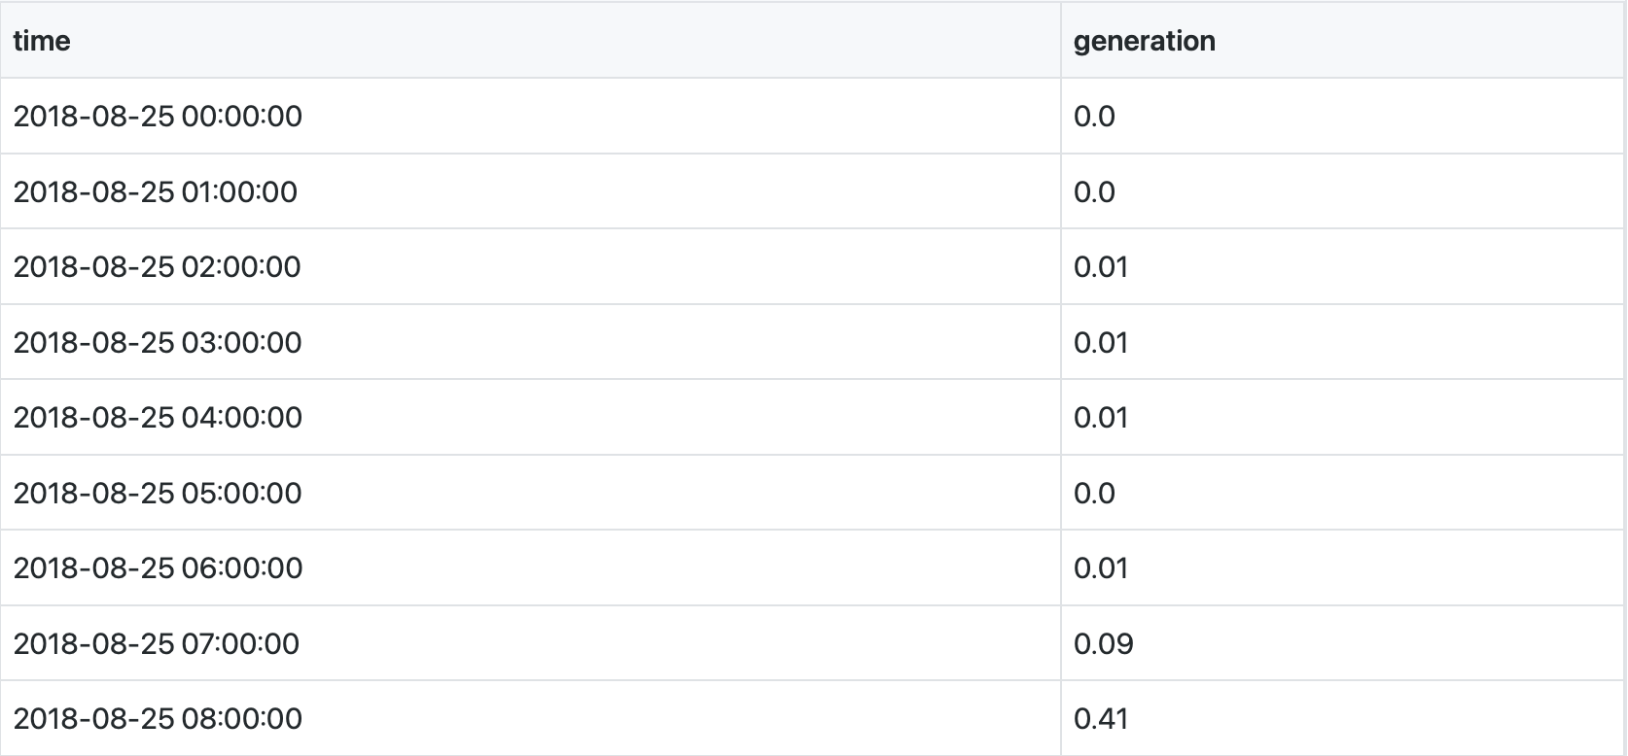
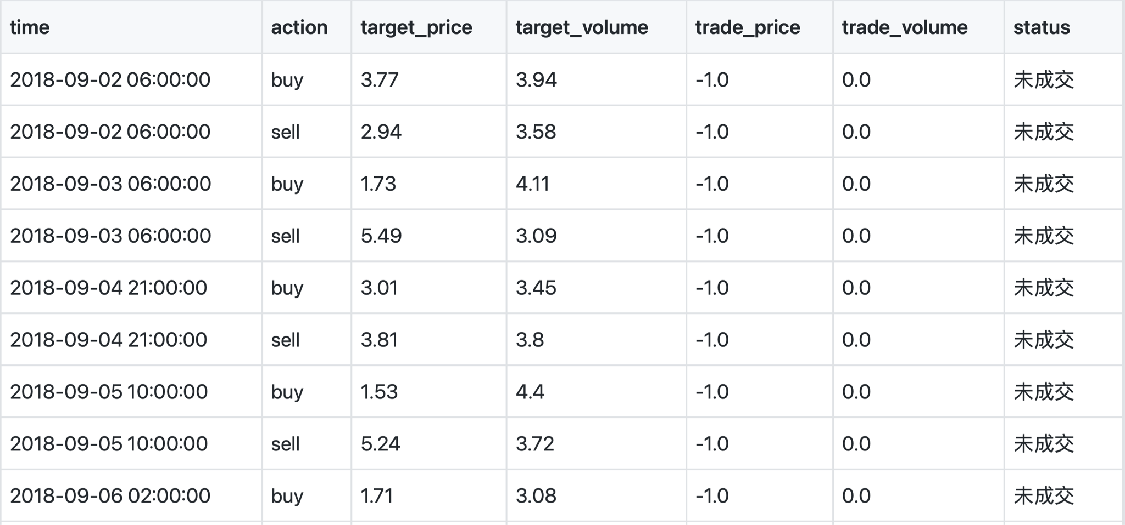
Data
Visualization of Power Consumption and Solar Power Generation Data
Hourly Power Consumption Data (kWh)
Hourly Solar Power Generation Data (kWh)
Bidding Records

Slide 8
Input Data
consumption.csv : 過去七天歷史用電資料
generation.csv : 過去七天產電資料
Column Name | Description | Unit
time | Power Consumption Time
consumption | Household power consumption value | kWh
Column Name | Description | Unit
time | Power Generation Time
generation | Household power generation value | kWh

Slide 9
Input Data
bidresult.csv : 過去七天自己的投標資料
Column Name | Description | Unit
time | bidding time（目標競標時間） | hour
action | bidding action (buy/sell)
target_price | bidding price (投標價) | TWD
target_volume | bidding volume (投標量) | kWh
trade_price | closing price (成交價)，-1 when bidding fails | TWD
trade_volume | closing volume (成交量) | kWh
status | bidding result (未成交 / 完全成交 / 部分成交)

Slide 10
Output Data
output.csv: 未來一天投標資訊
Column Name | Description | Unit
time | bidding time (目標競標時間) | hour
action | bidding action (buy/sell)
target_price | bidding price ( 競標價 ) | TWD
target_volume | bidding volume ( 競標量 ) | kWh

Slide 11
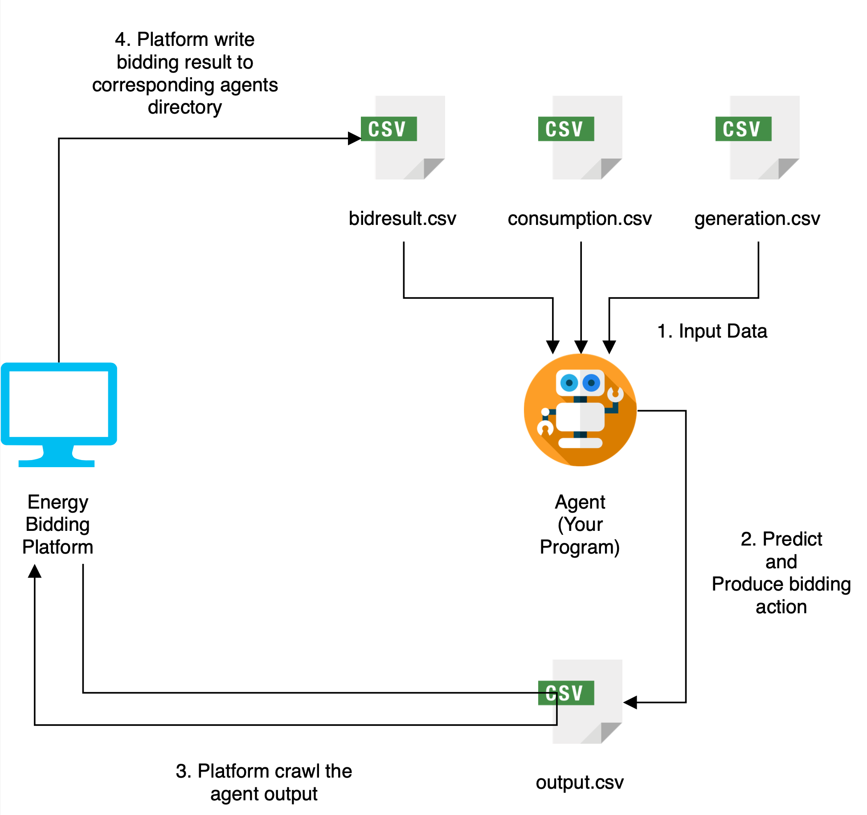
Workflow

Slide 12
Example - 8/1 (Beginning of the matching)
7/25 ~ 7/31
7/25 ~ 7/31
Null
Reminder:
Your Program must handle the null of bidresult.csv (with header)

Slide 13
Example - 8/2 (Second day of the matching)
8/1 ~ 8/1
7/26 ~ 8/1
7/26 ~ 8/1

Slide 14
Workflow
Platform inputs the past 7 days of consumption data(consumption.csv), generation data(generation.csv) and bidding records(bidresult.csv) to every agent
Agent generates the following day of hourly bidding action(output.csv) and outputs to the specific path
Platform crawls the bidding action of all agents and proceeds a bidding match
Platform announces the bidding result(bidresult.csv) and outputs it as a file to every agent’s directory

Slide 15
Workflow
平台會指定過去七天資料(cosumption, generation, bidresult) 作為參數放進 Agents 程式中
Agents 產出未來一天投標資訊(以小時為單位)，並可以透過參數指定輸出路徑
平台取得所有 Agents 的投標資訊，並進行媒合
平台公告結果並將競標結果寫到各個 Agents 的目錄

Slide 16
Action Type
Buy
Find a seller to buy your power with target_volume and target_price
If a transaction succeeds(成交), buyers always get the trade_volume with trade_price
Sell
Find a buyer to buy your power with target_volume and target_price
If a seller sells the amount that insufficiently supply to a buyer, seller needs to buy the power from Taipower and supplies it to buyer with the market price (市電單價), annotated as market_price.
No Action
Don’t output any bidding action to output.csv in these hours

Slide 17
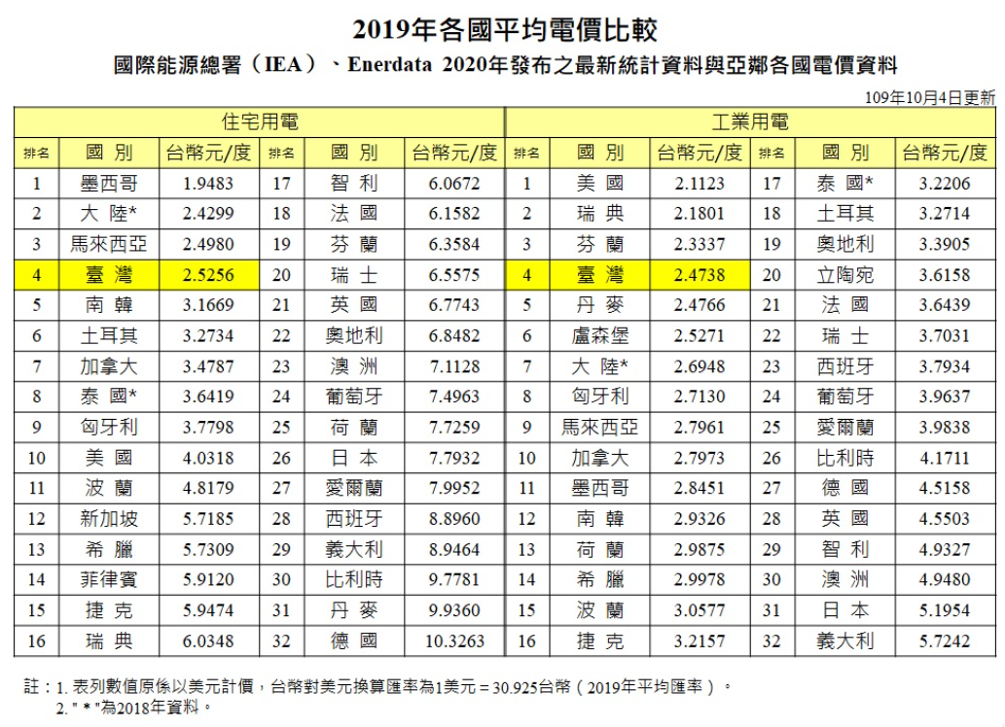
Market Price (市電單價)
Source: https://www.taipower.com.tw/tc/page.aspx?cchk=1b3221ee-37c3-4811-9d4d-a1bb215f33c8&cid=351&mid=213

Slide 18
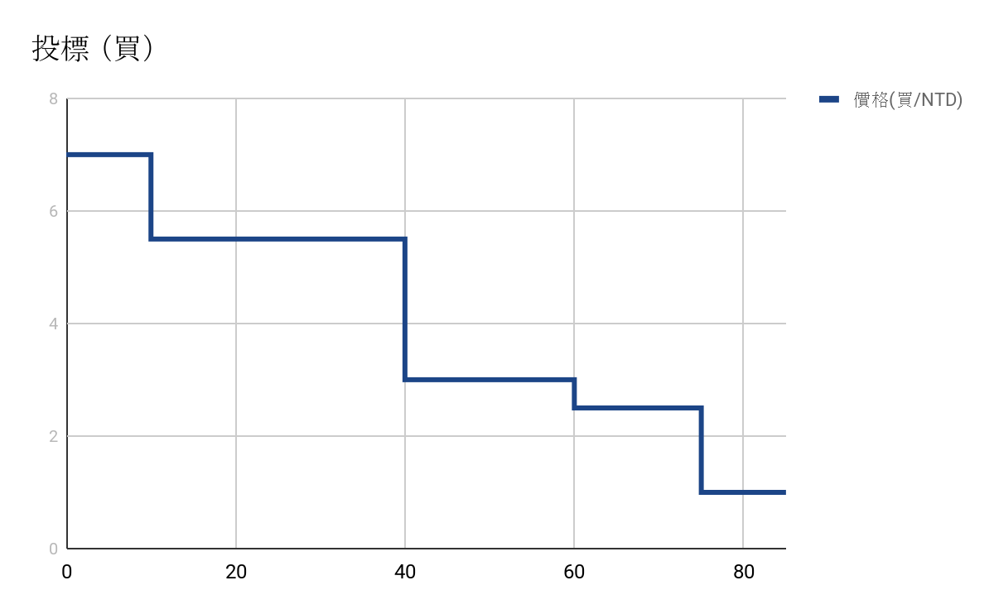
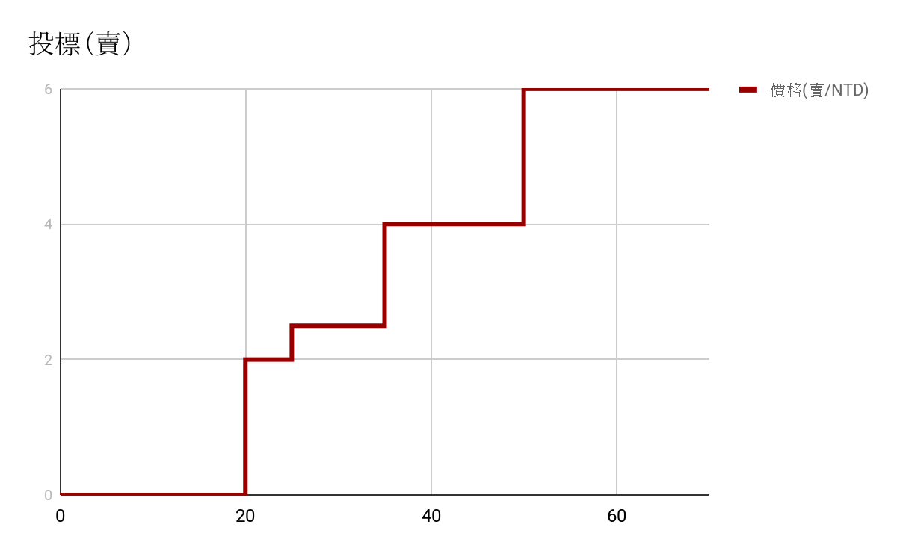
Match Mechanism
Single Bidding Price ( 單一成交價 ）
There is only a trade_price in an hour after platform proceeds a match
Buy
Sell
Price (TWD/kWh)
Price (TWD/kWh)
Volume(kWh)
Volume(kWh)
價錢 (NTD/kWh) | 7 | 5.5 | 3 | 2.5 | 1
電量 (kWh) | 10 | 40 | 60 | 75 | 85
價格 (NTD/kWh) | 2 | 2.5 | 4 | 6 | 6
電量 (kWh) | 20 | 25 | 35 | 50 | 70

Slide 19
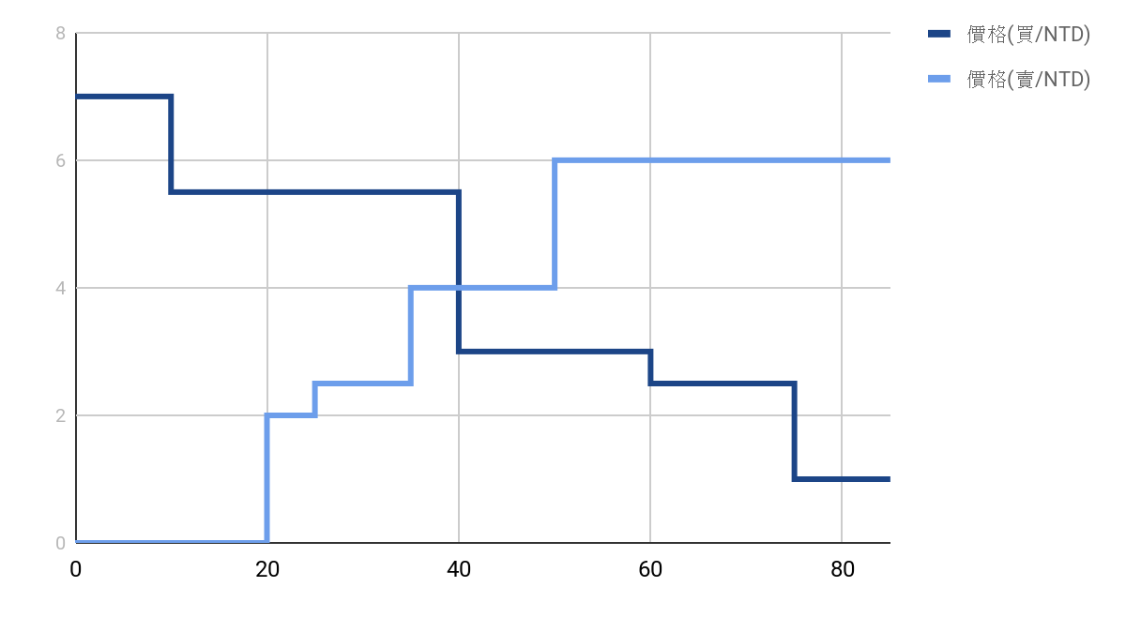
Matching Result
Price
(NTD/kWh)
Volume(kWh)
Volume (kWh) | 10 | 20 | 25 | 35 | 40 | 50 | 60 | 70 | 75 | 85
Buy Price (NTD/kWh) | 7 | 5.5 | 5.5 | 5.5 | 5.5 | 3 | 3 | 2.5 | 2.5 | 1
Sell Price (NTD/kWh) | 0 | 2 | 2.5 | 4 | 4 | 6 | 6 | 6 | 6 | 6

Slide 20
電費計算方式
𝚨 (從平台 賺/花 的錢)
𝚩 (正常使用電費的錢)
𝒂 = 買電量 - 賣電量 + 產電量
𝒃 = 𝒂 - 用電量
𝒂 >= 0 : 𝚨 = (買 - 賣) * 成交價
𝒂 < 0 : 𝚨 = (-1) * 產 * 成交價
𝒃 >= 0 : 𝚩 = 0
𝒃 < 0 : 𝚩 = (-1) * 𝒃 * 市電單價
𝚨
𝚩
Total =
+

Slide 21
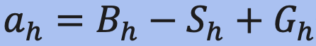
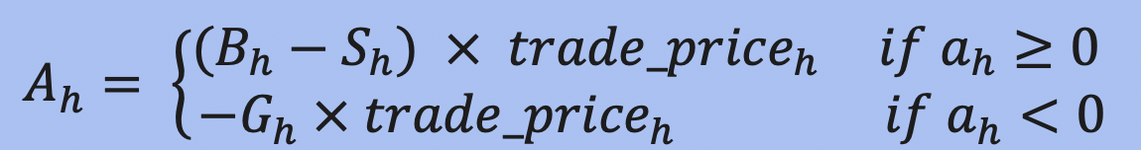
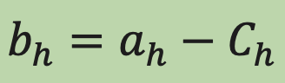
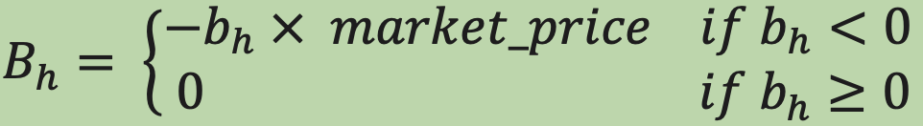
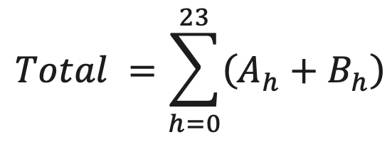
Electricity Bills (in a day)
( Money you spent/earned
from trading platform )
B_{h} | Total power brought from platform (kWh) in the h-th hour
S_{h} | Total power sold from platform (kWh) in the h-th hour
G_{h} | Total power generation (kWh) in the h-th hour
C_{h} | Total power consumption (kWh) in the h-th hour
trade_price_{h} | Bidding price in the h-th hour
𝚨
𝚩
( Money you spent
from general power consumption )

Slide 22
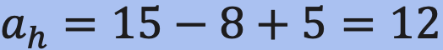
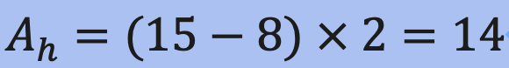
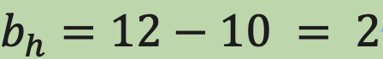
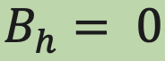
Electricity Bills Example (one hour)
𝚨
B_{h} | 15
S_{h} | 8
G_{h} | 5
C_{h} | 10
trade_price_{h} | 2
𝚩
Total = 14 + 0
= 14 (元)
Notes:
15-8+5=12, (15-8)*2=14
12-10 = 2 pass

Slide 23
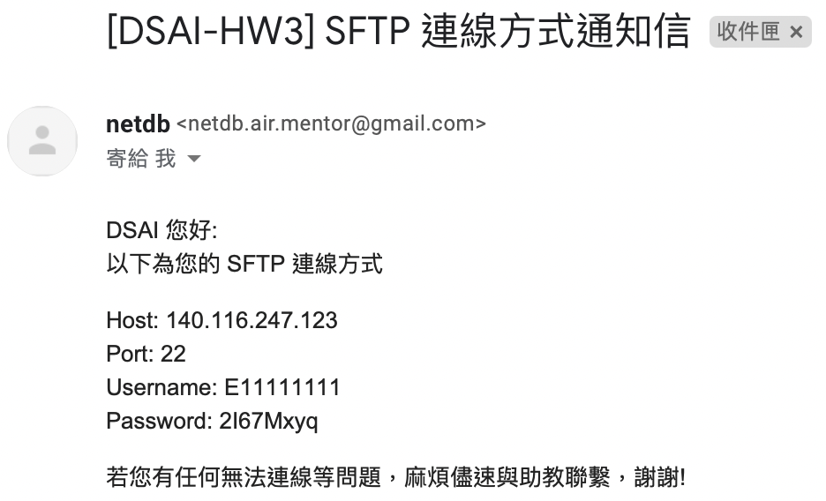
Homework Upload SFTP
Homework Template: https://github.com/NCKU-CCS/DSAI-HW3-2021
SFTP 連線資訊已寄送至組長信箱

Slide 24
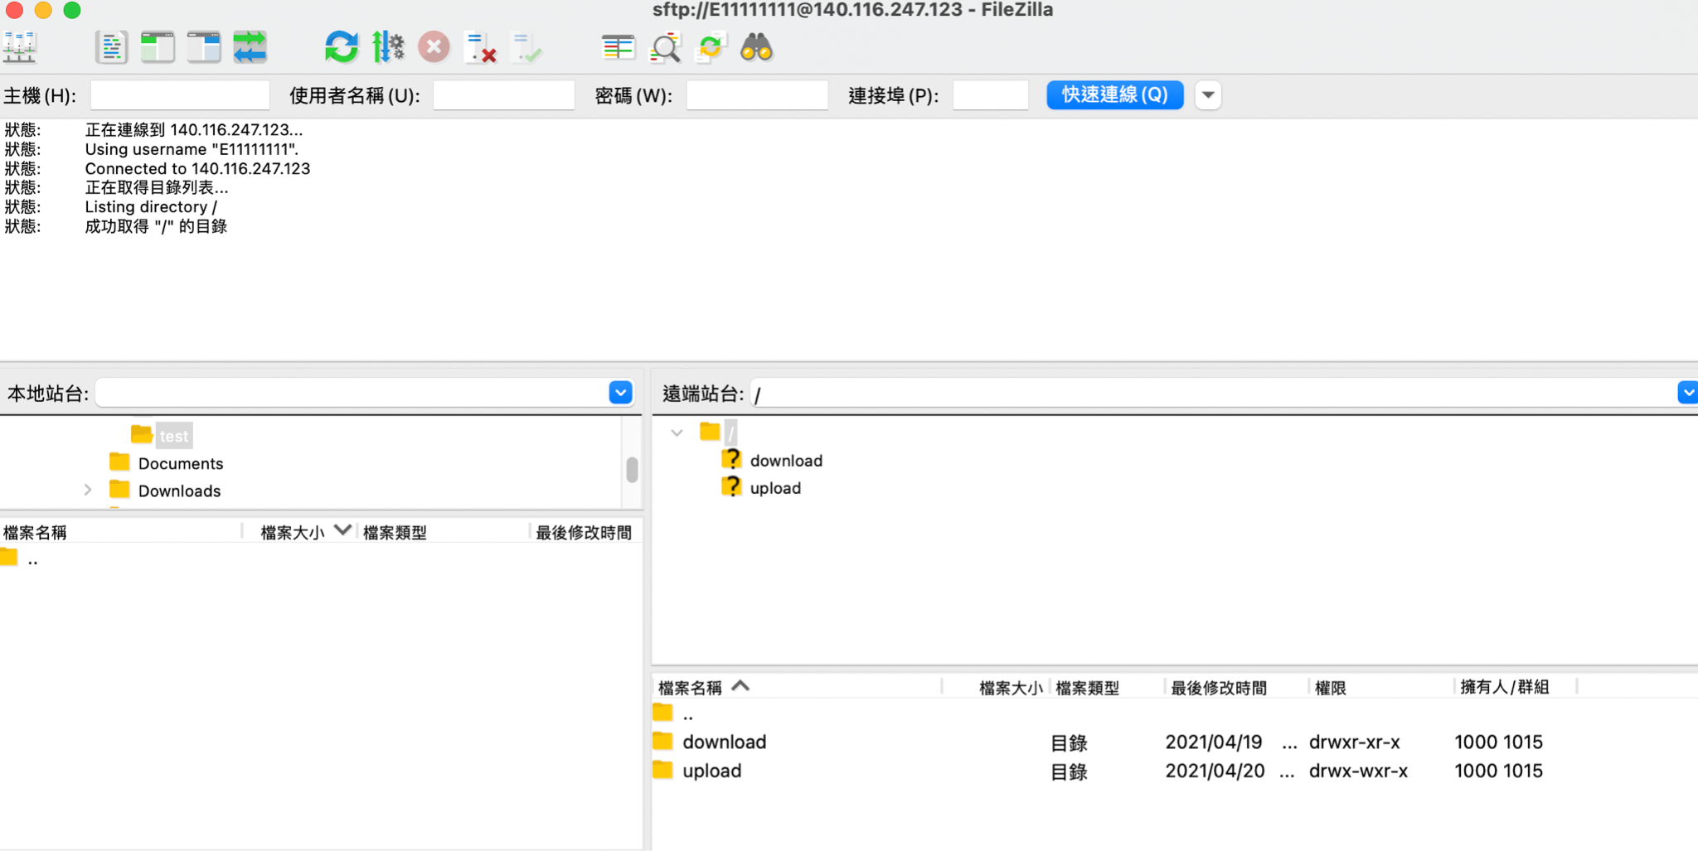
FileZilla

Slide 25
SFTP Path
┣━ upload/ # 上傳在此處
┗━ download/ # 下載
┣━ information/ # 每次交易資訊
┃ ┗━ info-{mid}.csv
┣━ student/
┃ ┗━ {student_id}/ # 每位學生媒合資料
┃ ┣━ bill-{mid}.csv # 帳單(天/筆)
┃ ┗━ bidresult-{mid}.csv # 投標結果(小時/筆)
┗━ training_data/
┗━ target{agent}.csv # 每個agent產耗電資料

Slide 26
Upload Rules
檔名統一為： {student_id}-{version}.zip
每次上傳新檔案時請往上加版本號，server 會自動讀取你的最大版本程式
┗━ {student_id}-{version}.zip # 請壓縮成 zip，不接受 rar
┗━ {student_id}-{version}/ # 解壓縮後必須還有一層資料夾
┣━ Pipfile # 務必使用 pipenv ，並用 python 3.8
┣━ Pipfile.lock
┣━ main.py # 程式進入點
┗━ {model_name}.hdf5 # 請儲存模型，不要重新訓練

Slide 27
Bidding Rules
Hourly bidding action(output.csv) should comply with the following specification:
An agent can sell or buy in the same hour, and the maximum number of taking actions is 100 a day
Bidding action should be in hour interval, format: %Y-%m-%d %H:%M:%S
Bidding price and bidding volume will be rounded to 2 decimal places
投標資訊需遵守以下規則：
同時段可以買賣，每日最多投標100筆
以小時為單位媒合，格式：%Y-%m-%d %H:%M:%S
投標價格與投標量皆以 0.01 為單位(四捨五入)

Slide 28
Schedule
Online Validation Phase (4/28 ~ 5/17)
Offline Testing Phase (5/18)
2021-04-28 00:00:00
Platform first match (validation set) 平台第一次媒合 (驗證資料集)
2021-05-17 18:00:00
Platform last match (validation set)
平台最後一次媒合 (驗證資料集)
2021-05-17 23:30:00
Hand-in the final version of agent
繳交最後版本程式
2021-05-18 12:00:00
Platform offline match (testing set)
平台線下媒合 (測試資料集)
Notes:
閉門造車 (8個月資料)- 給予 Testing 框架 讓學生帶回去 研發用
Online Validation (1個月資料) - 給予使用者 upload 個人模型 跟大家一起玩
Testing (3個月資料) - 把模型繳上來 助教自己測

Slide 29
Evaluation - Online Validation
Evaluation Table 評量表格
https://docs.google.com/spreadsheets/d/1cjhQewnXT2IbmYkGXRYNC5PlGRafcbVprCjgSFyDAaU/edit?pli=1#gid=0
Platform will evaluate all the agents every 6 hours and update the evaluation table
平台會每 6 小時進行媒合驗證，並更新評量表格
Platform uses the validation data set to matching 平台會採用驗證資料集進行媒合
Please send email to TA if there are any problems. TA will reply you ASAP. 有任何問題可以隨時寄信提問，助教會儘快回覆
Please test all possible problems in this phase 同學請在這階段儘可能測出所有問題

Slide 30
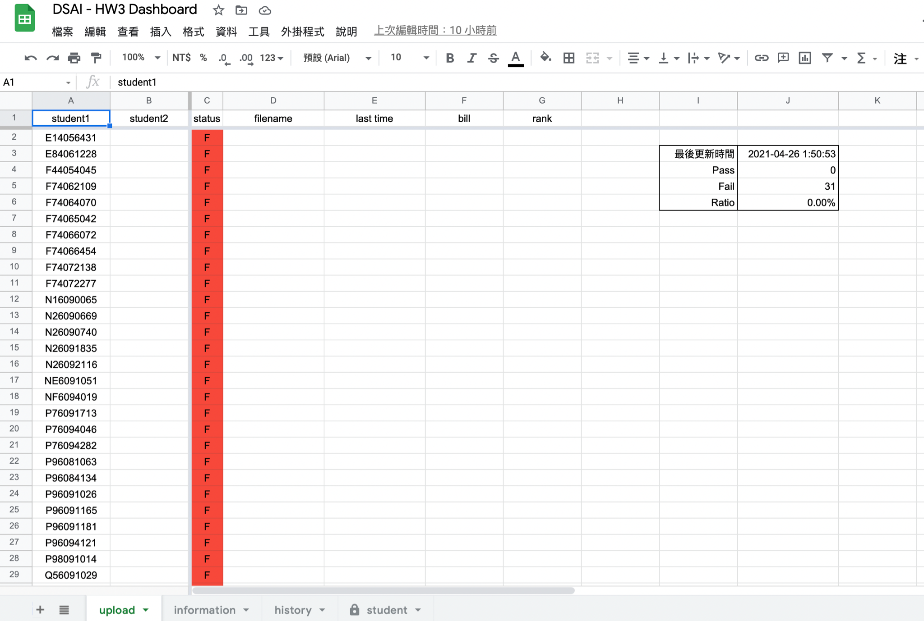
Evaluation Table (auto-generated)

Slide 31
Evaluation - Offline Testing Phase
Platform uses testing data set to matching offline 平台會採用測試資料集去進行線下媒合
Do not accept any personal programming error 不接受任何個人程式問題
If your agent is failure in this phase, you will get 0 mark. 跑不出結果，此階段直接 0 分

Slide 32
Evaluation
Every agents will act as every household once 每個 agent 每回合都會隨機為其中一個用戶競標，每個 agent 都會為每個用戶競標一次
Round : An agent completes bidding for the whole dataset (validation data set or testing data set) 回合： Agent 為用戶競標完一整個資料集 (驗證集 或 測試集)
Evaluation Metric : Total electricity bill of all round from a agent 評量指標：每回合的電費單加總
Platform will evaluate N round depends on the numbers of agents (N) 依據參與 agent 數(N) 執行 N 回合競標
Goal： Minimize all electricity bill
Example：
Agent: A, B, C
Household: a, b, c
Round | 1 | 2 | 3
Agent A | Household a | Household c | Household b
Agent B | Household b | Household a | Household c
Agent C | Household c | Household b | Household a

Slide 33
Grade
Online Validation Phase (50 %)
Execution Success : 50
Program Failure: 0
Offline Testing Phase (30 %)
Score: 30 - (ranking -1)
No.1 : 30 , No.2 : 29 , … , last: 1
Program Failure: 0
3. Documentation or Presentation (20 %)

Slide 34
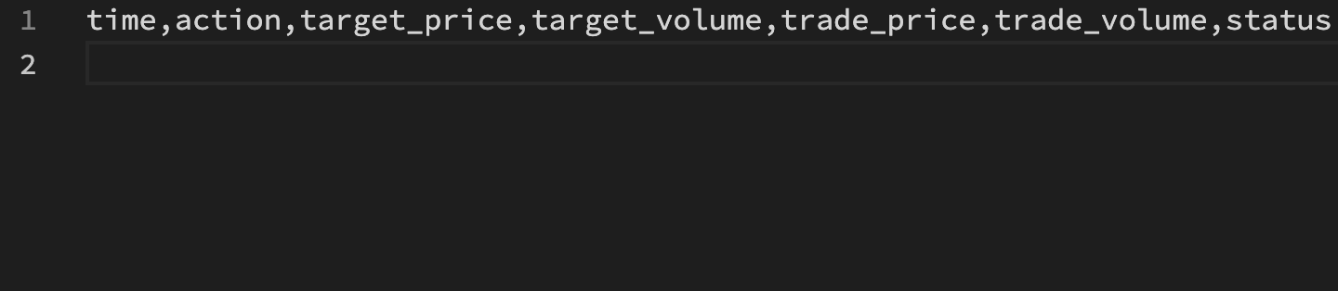
Question
bidresult.csv null 的狀況還是會有 header ，不是空資料或是沒有檔案，直接 read 這份取 data[0] 會跳錯，應該是要先判斷這份資料是不是 empty ，或是不要用編號index 直接去抓

Slide 35
Paper Reference
T. Chen and W. Su, "Indirect Customer-to-Customer Energy Trading With Reinforcement Learning," in IEEE Transactions on Smart Grid, vol. 10, no. 4, pp. 4338-4348, July 2019, doi: 10.1109/TSG.2018.2857449.
W. Tushar et al., "Grid Influenced Peer-to-Peer Energy Trading," in IEEE Transactions on Smart Grid, vol. 11, no. 2, pp. 1407-1418, March 2020, doi: 10.1109/TSG.2019.2937981.
K. Anoh, S. Maharjan, A. Ikpehai, Y. Zhang and B. Adebisi, "Energy Peer-to-Peer Trading in Virtual Microgrids in Smart Grids: A Game-Theoretic Approach," in IEEE Transactions on Smart Grid, vol. 11, no. 2, pp. 1264-1275, March 2020, doi: 10.1109/TSG.2019.2934830.
Li, Chaojie, et al. "Integrating Demand Response and Renewable Energy In Wholesale Market." IJCAI. 2018.
T. Carriere and G. Kariniotakis, "An Integrated Approach for Value-Oriented Energy Forecasting and Data-Driven Decision-Making Application to Renewable Energy Trading," in IEEE Transactions on Smart Grid, vol. 10, no. 6, pp. 6933-6944, Nov. 2019, doi: 10.1109/TSG.2019.2914379.
T. Carriere and G. Kariniotakis, "An Integrated Approach for Value-Oriented Energy Forecasting and Data-Driven Decision-Making Application to Renewable Energy Trading," in IEEE Transactions on Smart Grid, vol. 10, no. 6, pp. 6933-6944, Nov. 2019, doi: 10.1109/TSG.2019.2914379.
T. Morstyn, A. Teytelboym, C. Hepburn and M. D. McCulloch, "Integrating P2P Energy Trading With Probabilistic Distribution Locational Marginal Pricing," in IEEE Transactions on Smart Grid, vol. 11, no. 4, pp. 3095-3106, July 2020, doi: 10.1109/TSG.2019.2963238.

Slide 36
